Slide 1
CapStore
(E-Commerce Application)
Notes:
Usar para separador de capitulos . Seria bom ter esta versao em vermelho e verde tb..

Slide 2
CapStore is a web based e-commerce website that allows users to buy or sell products.
CapStore also allows users to sell their products, they need to register on to the website and need to be authorized by the admin of Capstore.
The CapStore Application performs the following
1. Signup, Login or Logout
2. Buy/sell products
3. Give review on products and return them.
4. Merchant- there can be two types of merchants, direct merchant and third party merchant. New merchants can be added or removed by admin. Merchants can add or remove products on CapStore.
5. Items can be added into cart and removed from the cart, after the final submission an invoice will be generated.
6. Customer can pay by different payment options

Slide 3
Business Analysis
By
Manasa Gundaji
ID: 152998-IN

Slide 4
Significance of the module:
Admin can generate business analysis at the end of some time period.
It can check the dispatch report of products from particular merchant.
Notes:
Fixar a posicao do titulo – sempre do lado esquerdo.
Sempre que tiver muito texto o coluna deve sempre ser “ narrowed” , se nao fica dificil de ler. Colocar paragrafos no texto.
Linha vertical deve ser mais fina e as pontas NUNCA devem ser arredondadas.

Slide 5
Product Table Description
Column Name | Datatype | Key Constraints | Description
ProductId | Integer | Primary Key | Unique for every product
ProductName | String |  | Name of Product
ProductPrice | Double |  | Price of product
ProductQuantity | Integer |  | Quantity of product
Date | date |  | Order date
Merchant Table Description
Column Name | Datatype | Key Constraints | Description
MerchantId | Integer | Primary Key | Unique for every merchant
ProductName | String |  | Name of Product
ProductPrice | Double |  | Price of product
ProductQuantity | Integer |  | Quantity of product
Date | date |  | Date of Inclusion

Slide 6
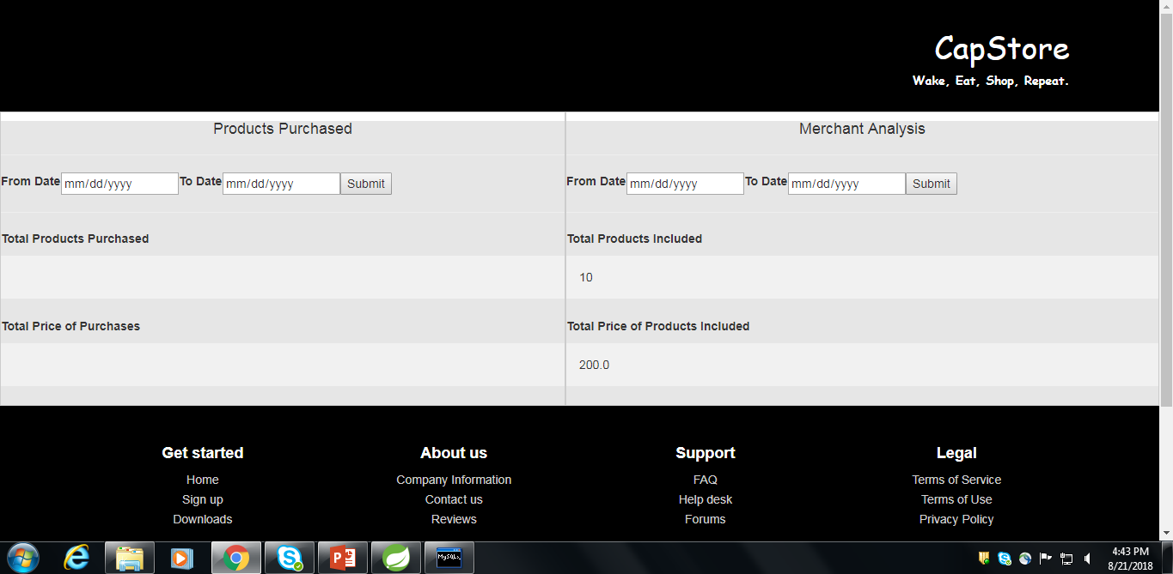

Slide 7
Thank You

